Slide 1
Applied Geographic Information Systems and GIS Programming
Yi Qiang （强毅）
Department of Geography
University of Hawaii - Manoa

Slide 2
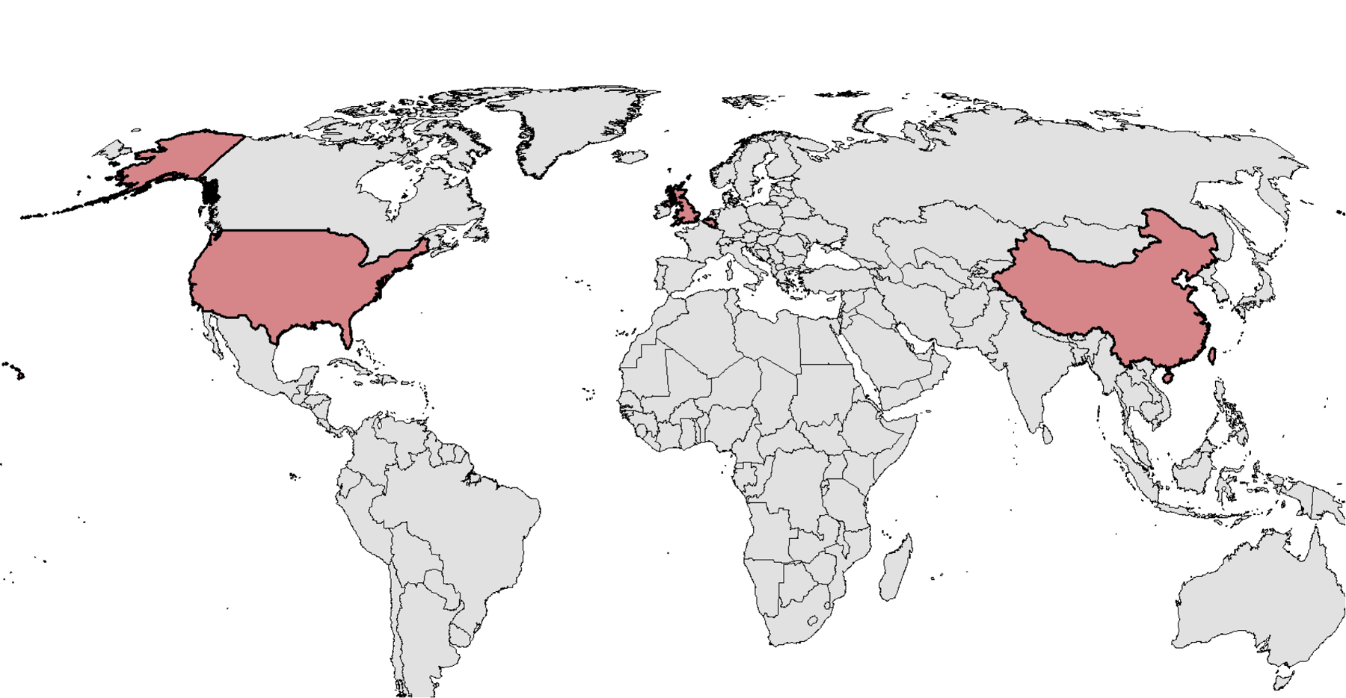

About Me
2017 – Now, Assistant Professor at University of Hawaii
2016 July – Dec, Research Associate at University of Colorado - Boulder
2013-2016, Postdoc at Louisiana State University
2012 Ph.D. in geography, Ghent University, Belgium
2007 M.Sc. in geographical information science, University of Edinburgh, UK
2006 B.Sc. in geographical information systems, Beijing Normal University, China

Slide 3
My research interests
Spatio-temporal modeling
Natural Hazard
Geovisualization
GIS
Resilience & Sustainability
Geocomputation
Environment Modeling
Fundamental research
(GIScience)
Practical research
(GISystems)

Slide 4
What is GIS
What is GIS?
Why you want to study GIS?
How do you use GIS in your study/research?

Slide 5
What is GIS
GIS refers to GIScience or GISystem
The former focuses on methodology, and the latter focuses on the tools and systems that support the methodology
GISystem: A computer system that collect, manage, model, and analyze geospatial data to understand relationships, patterns, and trends in the data.
GIScience: the scientific discipline that studies geospatial data structures and computational techniques to capture, model, process, and analyze geographic information.

Slide 6
Where GIS can be applied
Urban and regional planning
Natural resource management
Transportation and logistics analysis
Natural disaster mitigation and adaptation
Emergency management
Terrain analysis
Public health and epidemiology analysis
Millitary
and more…

Slide 7
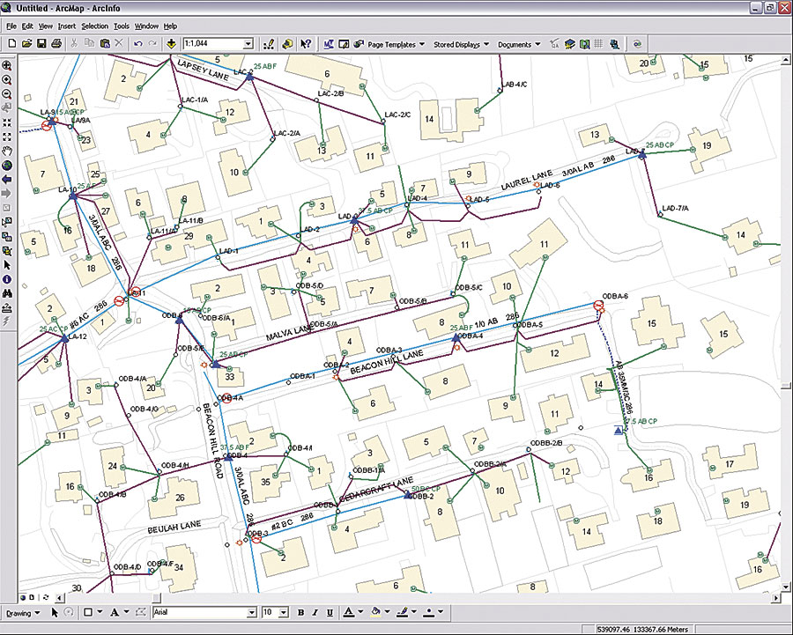
What GIS does? - A Day with GIS
7:00am, my alarm clock goes off… The energy to power the alarm comes from the local energy company, which uses a GIS to manage all its assets (e.g. electrical conductors, devices, and structures) so that it can deliver electricity continuously to customers.

Slide 8
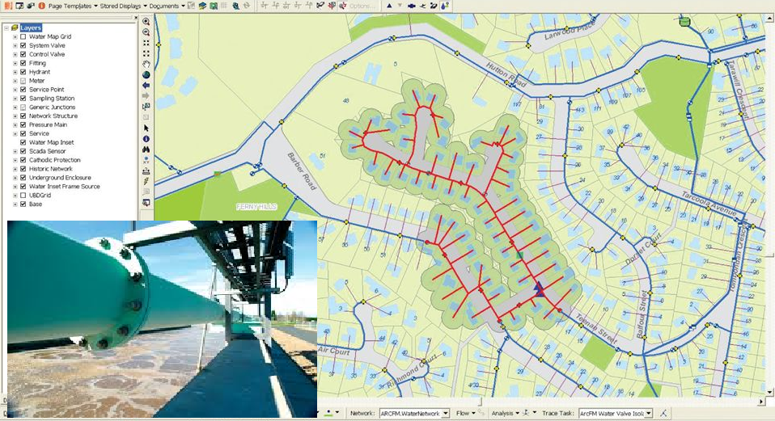
What GIS does? - A Day with GIS
7:15am, I jump in the shower… The water for the shower is provided by the local water company, which uses a hydraulic model linked to its GIS to predict water usage and ensure that water is always available to it customers.

Slide 9
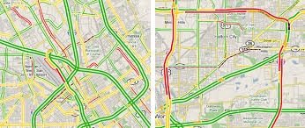
What GIS does? - A Day with GIS
8:00am, I plan my travel to my office… I turn on my smart phone to check the traffic condition on my way to office. It turns out there is a long pipe-up on the highway from my home to office. The GIS in the App suggests that taking a bus is faster than driving.
Real-time traffic in GIS

Slide 10
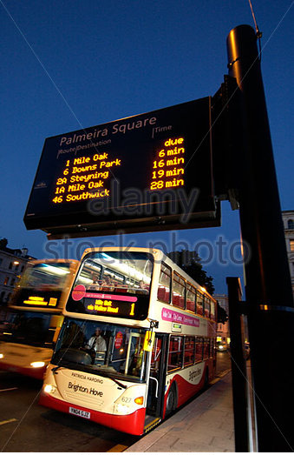
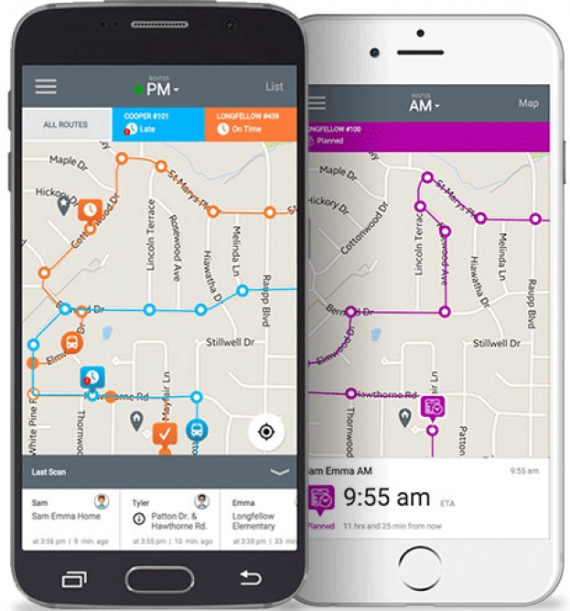
What GIS does? - A Day with GIS
8:15am, I catch the bus… At the station, the waiting times for different buses are displayed in a LED board using the real-time locations from GPS installed in the buses. I can also check this information as well as current locations of buses from an App in my smart phone.
Bus waiting time at bus station
Tracking bus location in a mobile App

Slide 11
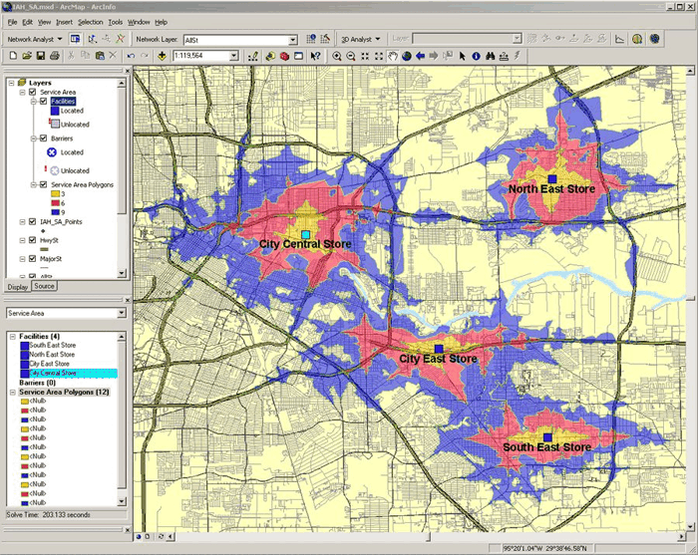

What GIS does? - A Day with GIS
8:45am, I arrived at my office… I work at a grocery company (e.g. Walmart). The manager is call for a meeting to discuss the location of a new branch. We have invited a GIS consultant company to assess the best location of the new store, which will be close to our potential customers and have lowest land price and building cost.
Accessibility to grocery stores

Slide 12
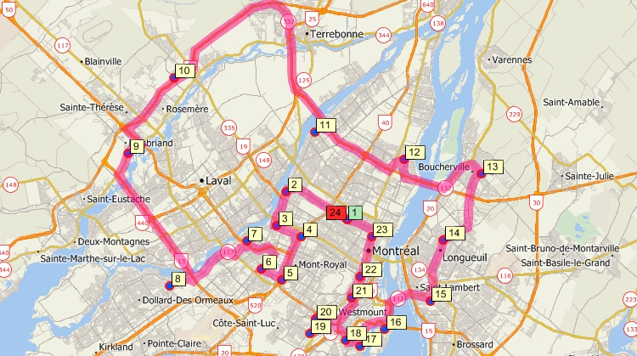
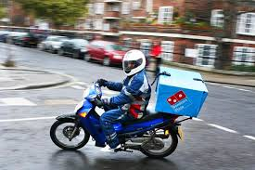
What GIS does? - A Day with GIS
11:45am, I feel hungry… I am ordering my lunch from Domino Pizza. The manager use a GIS to figure out which deliveries should go out together and plan the best delivery route for the delivery staff.
Use GIS to plan delivery route

Slide 13
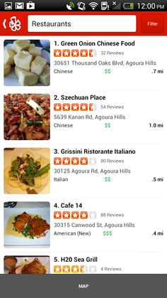
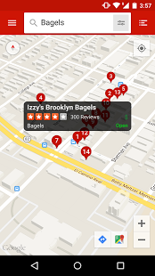
What GIS does? - A Day with GIS
5:00pm, I am off work. I plan to have dinner with some friends at a certain place. I use GIS to search for restaurant near that place and plan my route to the restaurant.
Query for restaurants near a location in GIS
Checking for restaurant reviews contributed by volunteer users

Slide 14
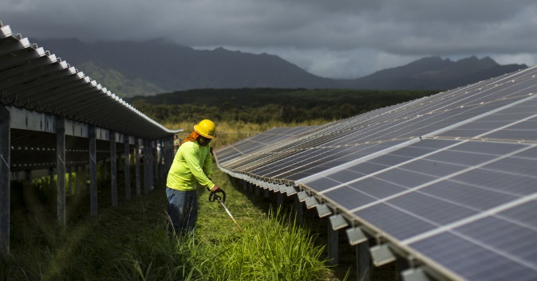
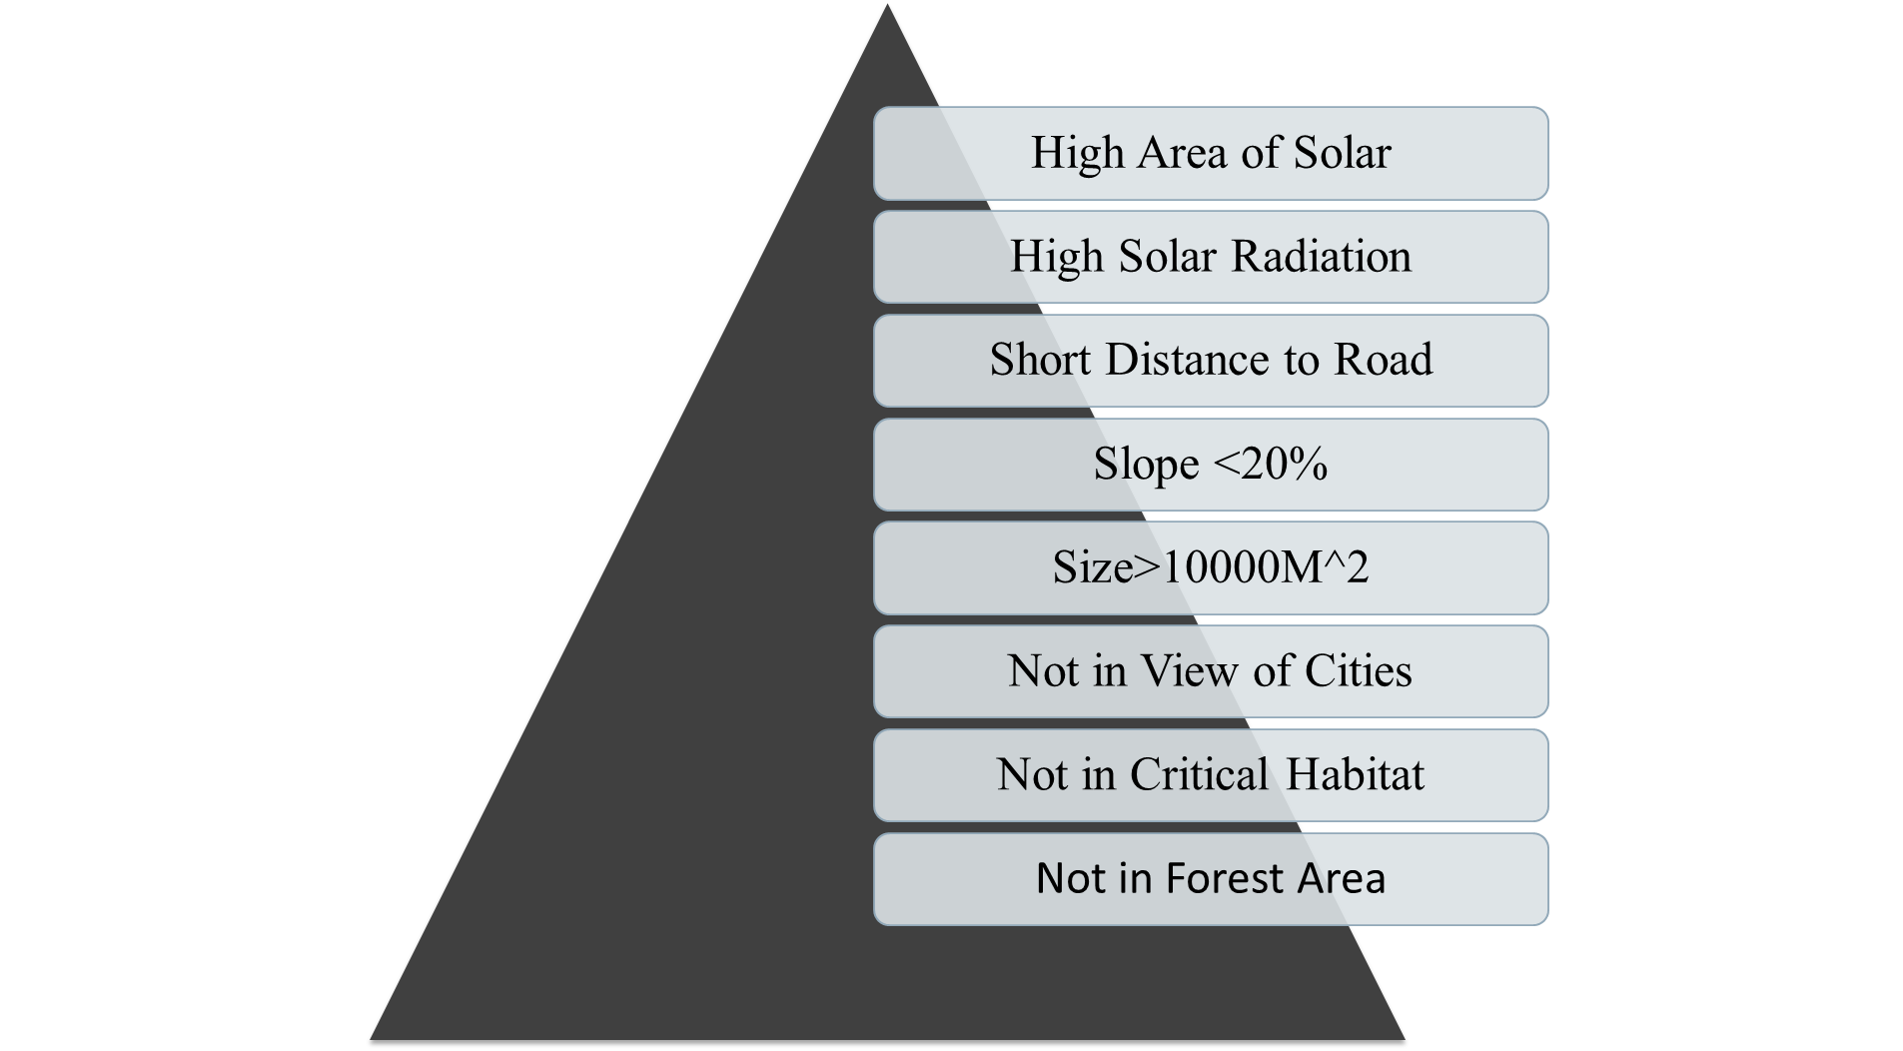
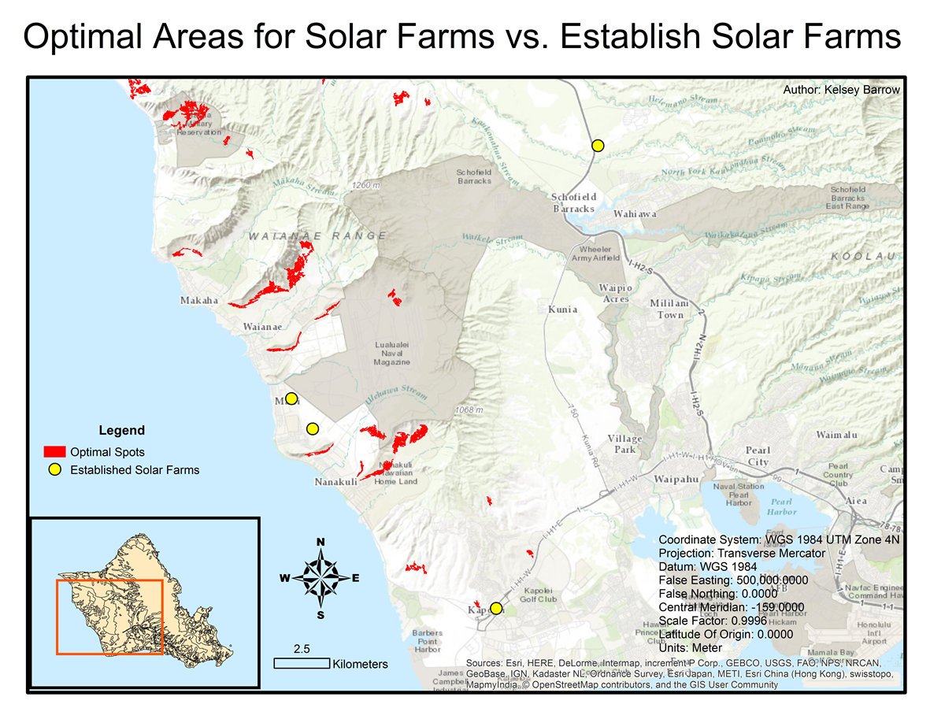
GIS in Planning
Finding suitable locations for different types of development, for instance, solar farm

Slide 15
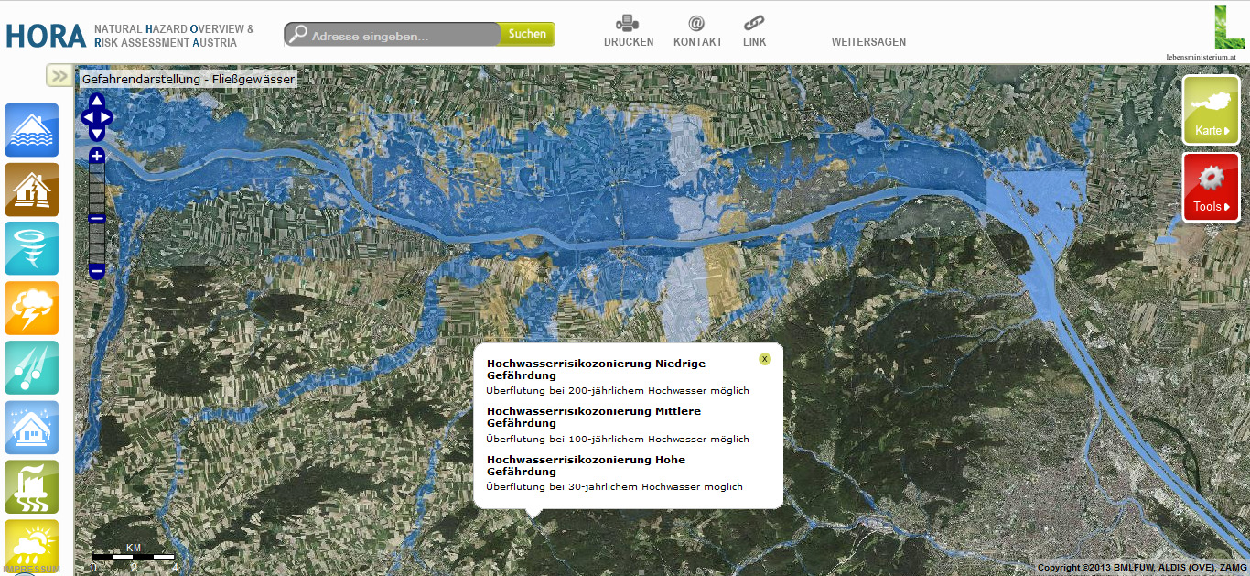
GIS in Hazard Mitigation
Use GIS to assess risk, exposure, and vulnerability to flood, wildfire and sea level rise

Slide 16
GIS in Hazard Mitigation
Use GIS to assess risk, exposure, and vulnerability to flood, wildfire and sea level rise
Precipitation
Slope
Land cover type
Land slide risk

Slide 17
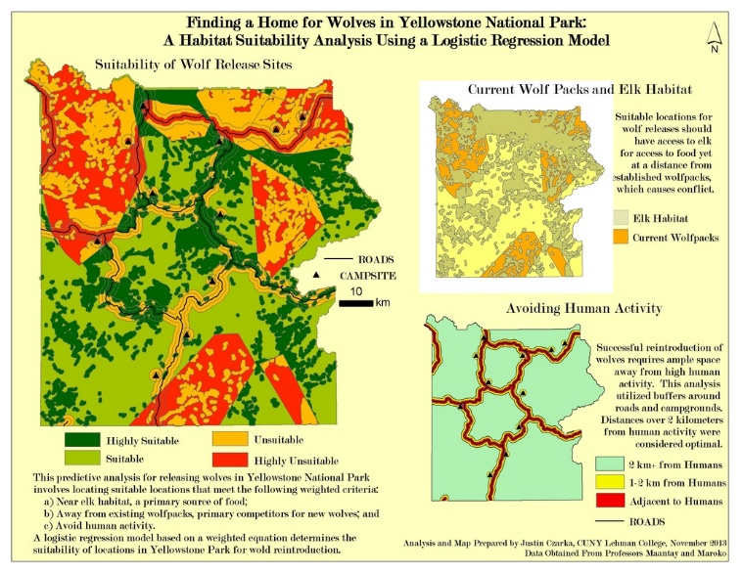
GIS in Environment Conservation
Use GIS to find suitable habitat of certain species – guide delineation of conservation area or wildlife refuges.
EA3692652

Slide 18
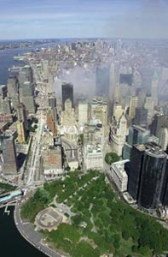
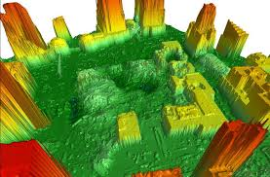
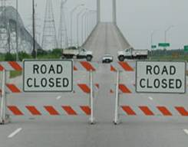
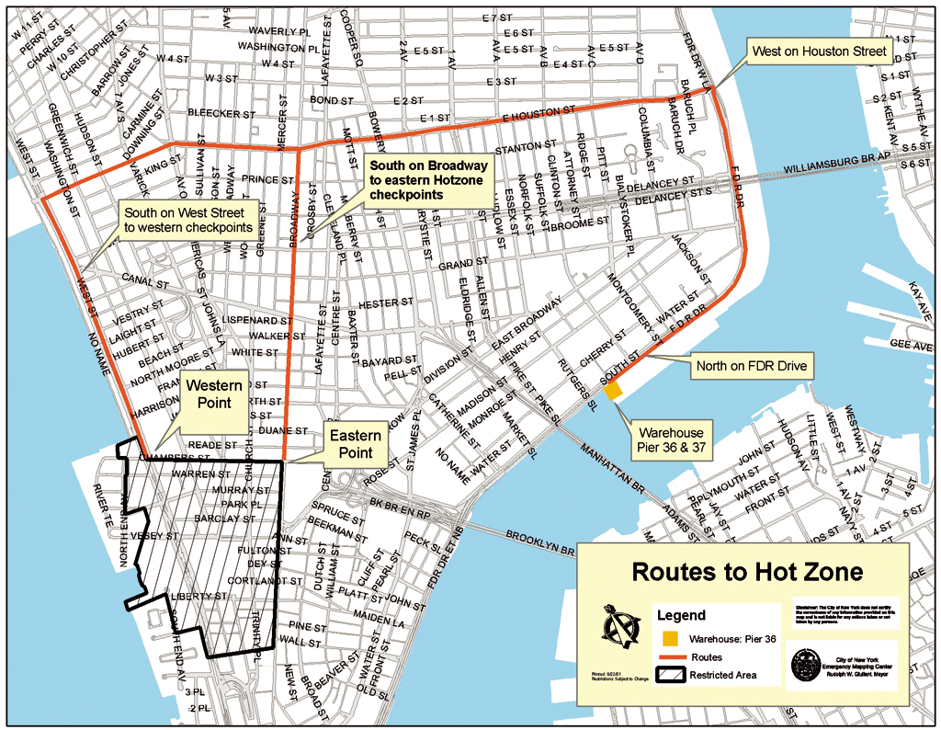

GIS in Emergency Management
Manage and allocate assistance resources to reach the destination efficiently
Delineate functional zones to facilitate evacuation and recovery
DEM post-911
September 11, 2001
The mapping center within the EOC was equipped with 20 GIS workstations and five plotters.

Slide 19
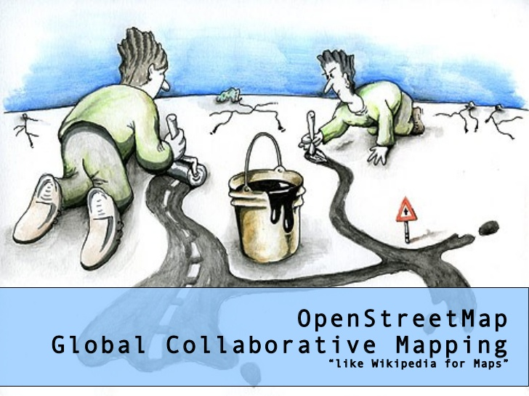
Public Participation GIS and Volunteer GIS
Creating a free editable map of the world by numerous volunteer users. (typical example: OpenStreetMap)
Map data is collected from scratch by volunteers performing systematic ground surveys using tools such as a handheld GPS unit, a notebook, digital camera, or a voice recorder.

Slide 20
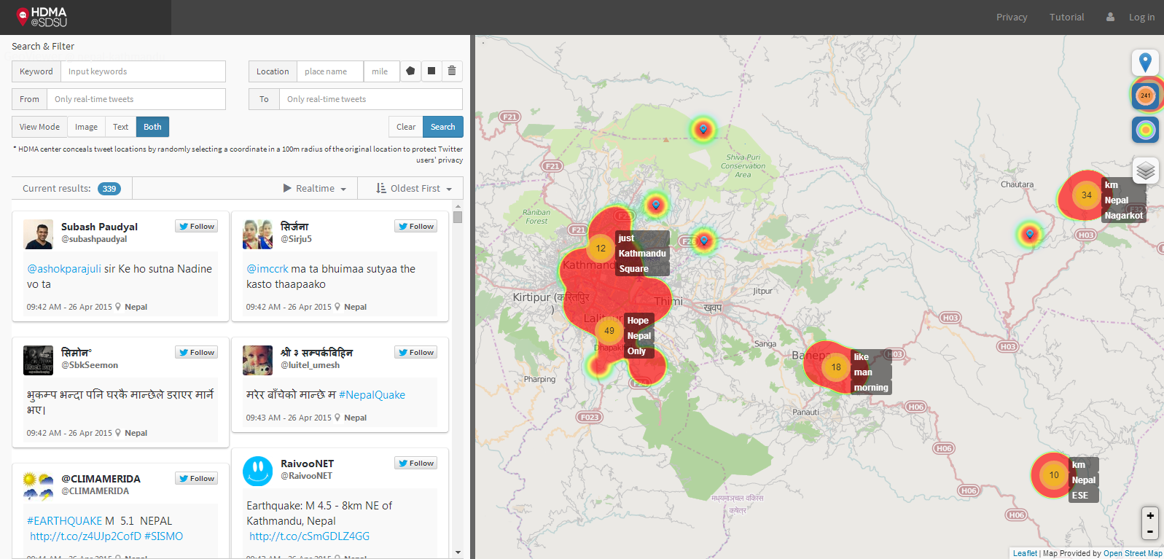
GIS and social media

Slide 21
Typical scientific questions in GIS
Rational, effective, and efficient allocation of resources, in accordance with clearly stated criteria
Monitoring and understanding observed spatial distributions
Understanding the difference that place makes – identify which characteristics are inherently similar between places.
Understanding dynamic processes in the natural and human environments, such as processes of coastal erosion or urban growth
Support location-based decision-making – answering questions about where using data from multiple sources.

Slide 22
Applied GIS
Part I: Principles
An Introduction to GIS
Representing the World in GIS
Part II: Techniques
GISystems
Geospatial Data
Geodatabase
Part III: Analysis
Cartography and Map Production
Geovisualization
Spatial Analysis
GIS Modeling
GIS Programming
Part I: Python
Object-oriented programming
Syntax of Python
Python interface and modules in ArcGIS
Part II: GIS Data Access Using Python
Working with vector data
Working with raster data
Part III: Advanced GIS Modelling in Python
Automation of GIS processing tools
Dynamic modeling in GIS

Slide 23
Course Structure
No prerequisite knowledge in GIS or programming
Combination of theories, applications and case studies
Including both lectures and lab exercises
Develop hands-on skills in GIS analysis and modeling
Getting started with Python Programming in GIS

Slide 24
Course Regulation
Do
Speak English in Class
Ask anytime when you have questions (raise your hands)
Open discussion is encouraged (raise your hands)
Contact me after class
Do not
Be late (>15min late deemed as absence)
Talking
Use cell phone in class (mute your cell phone)
Other disruptive behavior
Speak Chinese

Slide 25
My contact information
Email: yiqiang@Hawaii.edu
Website: qiang-yi.github.io
Course materials (lectures and lab exercises): https://github.com/qiang-yi/NUAA

Slide 26
Topic 2: Data Representation in GIS
We all live on the surface of the Earth, and spend most of our lives in a relatively small fraction of it.
Almost all human activities require knowledge about the Earth that are outside of our direct experience.
Traditionally, the knowledge about the Earth is documented in verbal description (book), visual description (maps), or in our brain (mental concept we began to develop as young children).
In digital representation (GIS), the knowledge of the Earth is formalized as data models – the structures and rules that accommodate data.

Slide 27
Data representation in GIS
An atom of geographic data (i.e. a datum) consists of a space, a time and some descriptive properties (attributes), for instance,
“The average income at Boulder, CO in 2014 is $69,407”
“The elevation (m above sea) at latitude 27.986065, longitude 86.922623 is 29,029m, which was measured in 1955.”
“State of Hawaii vote for Democratic Party in 2016 US presidential election”
Where
When
What
Three Ws in geographic data

Slide 28
Types of Attributes
Nominal: the simplest type of attribute, serves only to identify or distinguish one entity from another. For example, place names or house number.
Ordinal: values that have a natural order. For instance, Canada rates its agricultural land by classes of soil quality, with Class 1 being the best, Class 2 not so good, etc…
Interval: if the difference between values make sense. For instance, Celsius temperature is interval attribute, because 30°C and 20°C is as different as 20°C and 10°C
Ratio: if the ratio between values make sense. For instance, weight is ratio, because 100kg is twice as 50kg.

Slide 29
Representation of Time
Time point: a point on the time line, e.g. Sept. 11, 2001 or 19:51:32
Time interval: an extent on the time line, e.g. from 1949 to 2017, from 9:00am to 17:00pm.
Time cycles: a repeating point or interval along the time line, e.g. every Monday afternoon.

Slide 30
Representation of Space
The two fundamental ways of representing space are discrete objects and continuous fields.
The discrete view: the world is empty, except where it is occupied by objects with well-defined boundaries that are instances of generally recognized categories, for instance, a house, a lake, a car or a people on the Earth surface.
An discrete object can be represented as a point, lines, or polygon, or polyhedrons (3D)

Slide 31
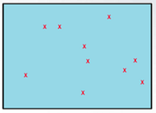
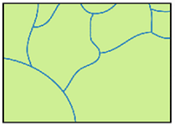
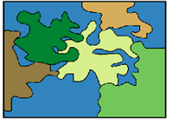
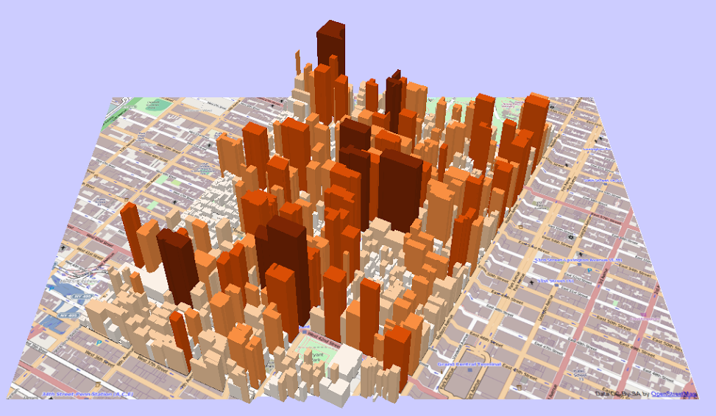
A discrete world
Points
Lines
Polygon
3D polygons

Slide 32
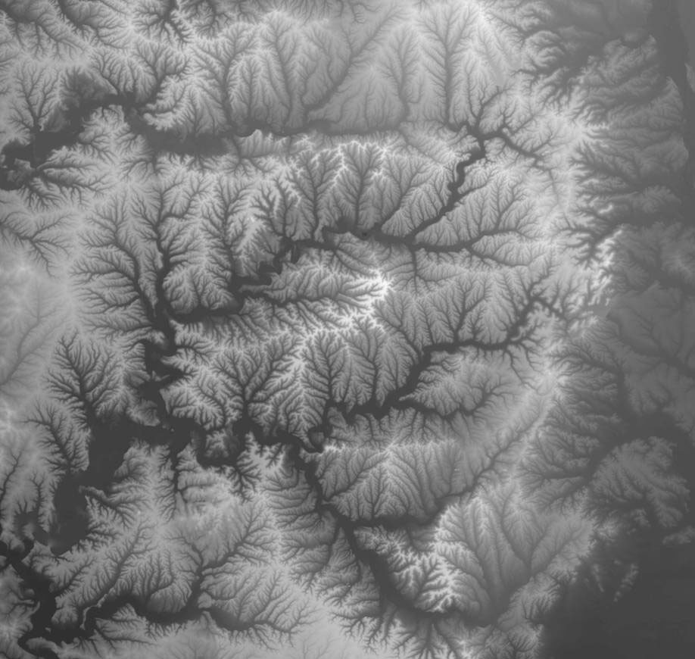
The continuous view
Some geographic processes do not have discrete boundaries, e.g., urban area, freshwater wetland, Chinatown.
The continuous field view represents the real world as a finite number of variables, each one defined at every possible position.
Digital elevation data

Slide 33
Rasters and Vectors
Continuous and discrete are two conceptual views of the world.
Raster and vector are two digital representations of the world in GIS.
Strictly speaking, both raster and vector can model continuous and discrete world. However, raster is more associated with the continuous view, while vector is more used for the discrete view.

Slide 34
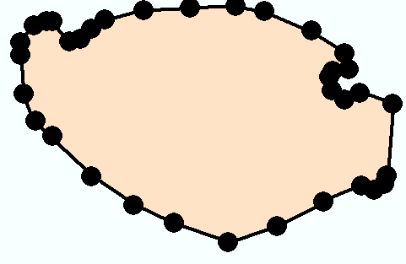
Vector model
Features are stored as a series of x-y coordinates in a rectangular coordinate system.
Many different coordinate systems may be used.
Polygon
Vertices
Line
Points
Nodes
Y
X

Slide 35
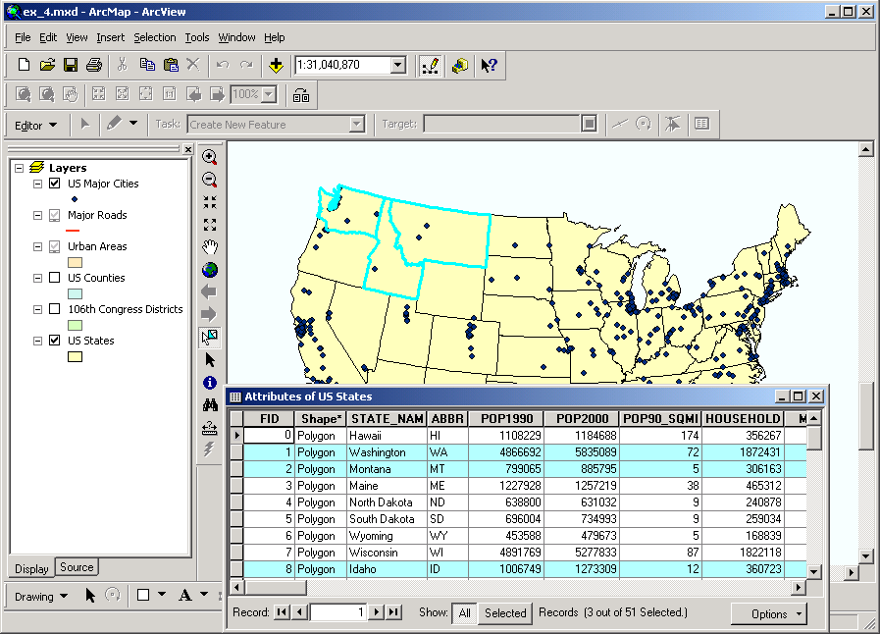
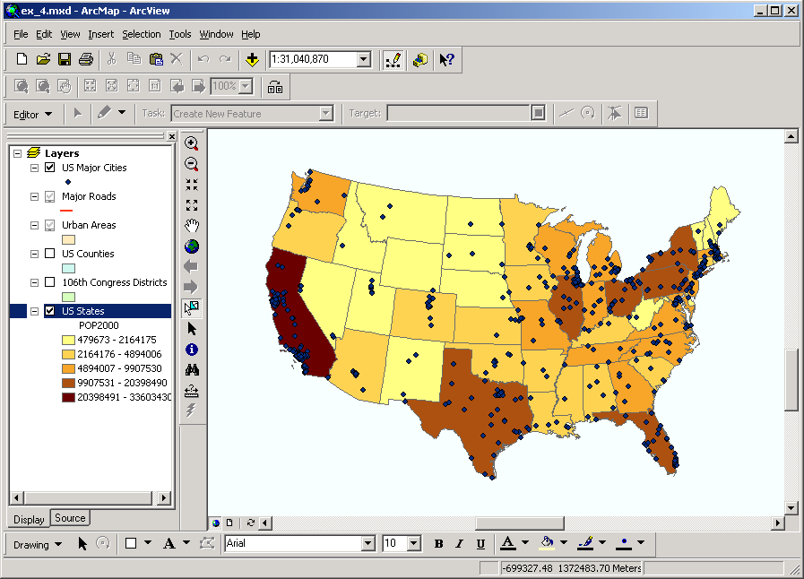
Features linked to data
Each feature is linked to an entry in a data table containing information about the feature.

Slide 36
Advantages of vectors
Precise location of features
Storing many attributes
Flexible for cartography
Compact storage of information
Ideally suited for certain types of analysis, especially areas, lengths, connections

Slide 37
The raster data model
X, Y location
X, Y location
Columns
Rows
Raster data file
N rows by M columns
Georeferenced to earth’s surface

Slide 38
Raster and Vector Data
Raster data are described by a cell grid, one value per cell
Vector
Raster
Point
Line
Zone of cells
Polygon
Notes:
DRM

Slide 39
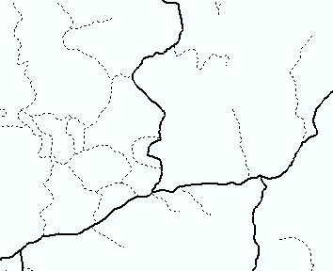
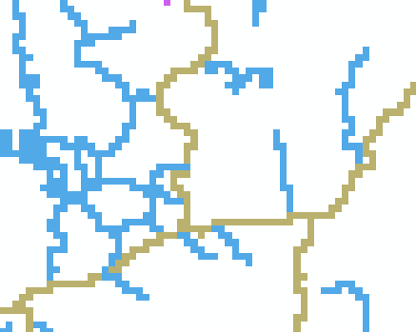
GIS data models
Vector model
Raster model

Slide 40
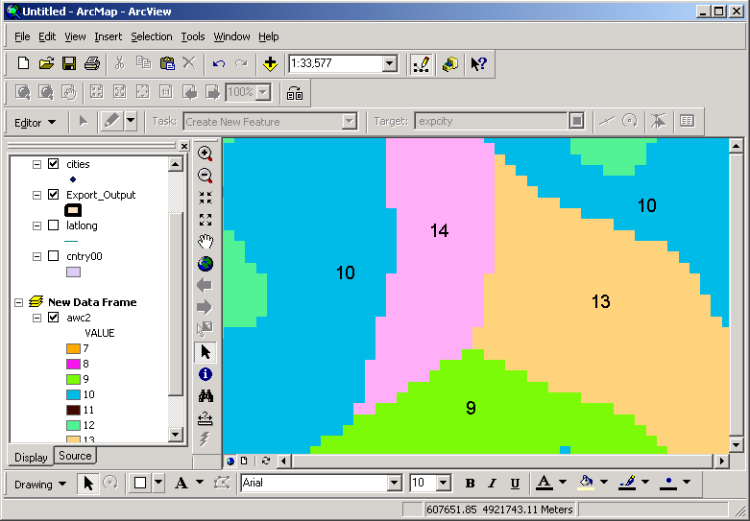
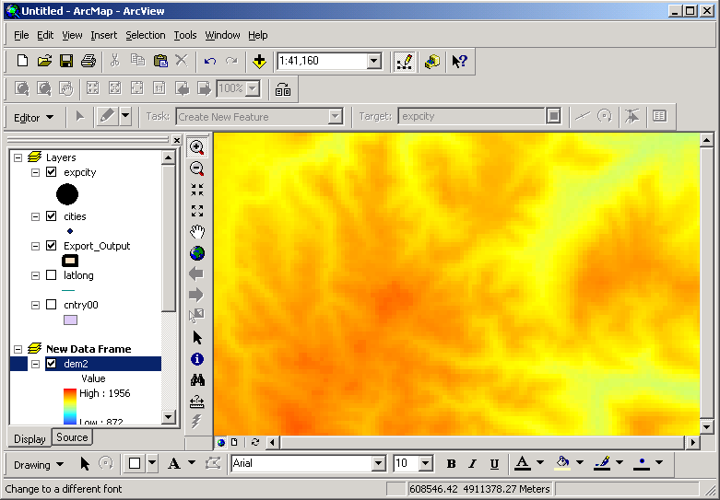
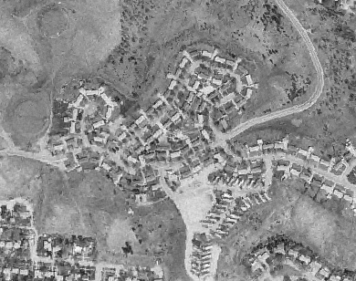
Types of raster data
Discrete raster: land use
Continuous raster: DEM
Continuous raster: image
Discrete raster: roads

Slide 41
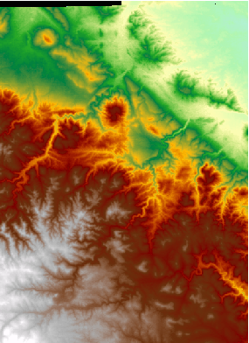
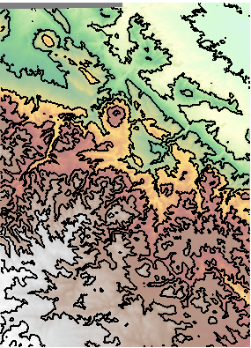
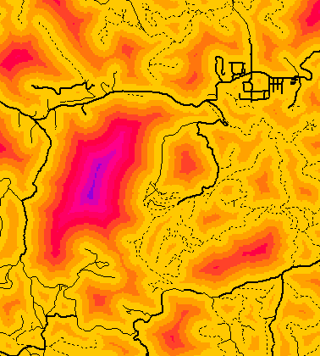
Continuous data
Raster is the best way to store continuously changing values such as elevation
Analysis faster and more flexible than vectors for many applications
Some analysis only possible using rasters

Slide 42
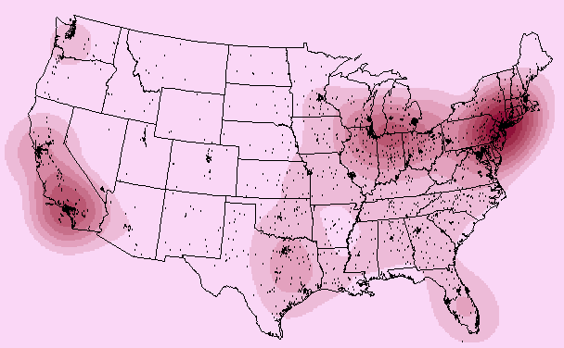
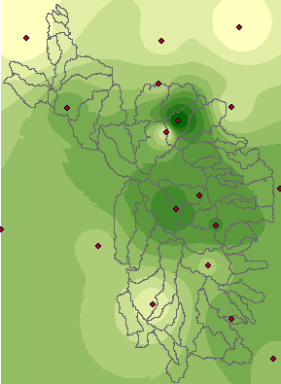
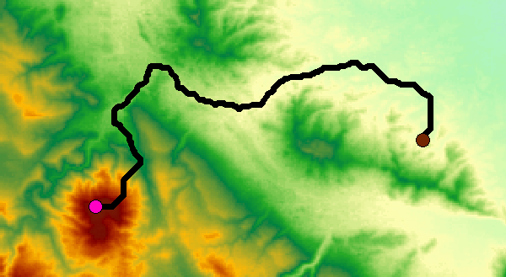
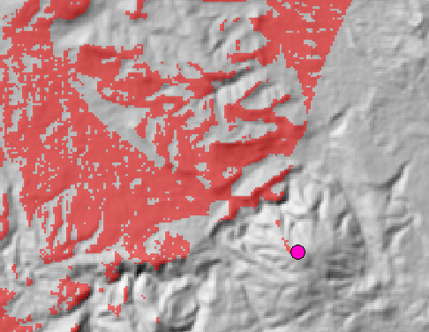
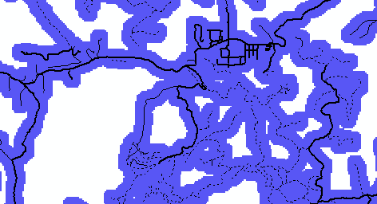
Raster analysis functions
Distance
Interpolation
Density
Least cost path
Viewshed
Buffers

Slide 43
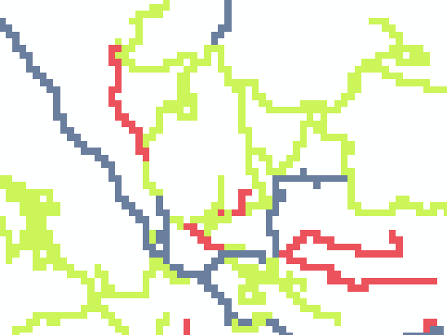
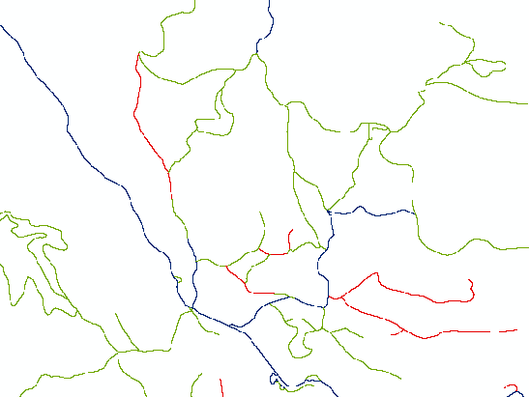
Impact of resolution
90m resolution
Storage space increases by the square of the resolution
Portraying large areas at high precision is problematic
10m resolution

Slide 44
Storage of attributes
Roads may have other attributes: ownership, speed limit, number of lanes, etc.
Would need a new raster for each attribute
Only numeric attributes may be stored
Raster contains 1 value indicating a single attribute—road type for example

Slide 45
The raster data model
X, Y location
X, Y location
Columns
Rows
Raster data file
N rows by M columns
Georeferenced to earth’s surface

Slide 46
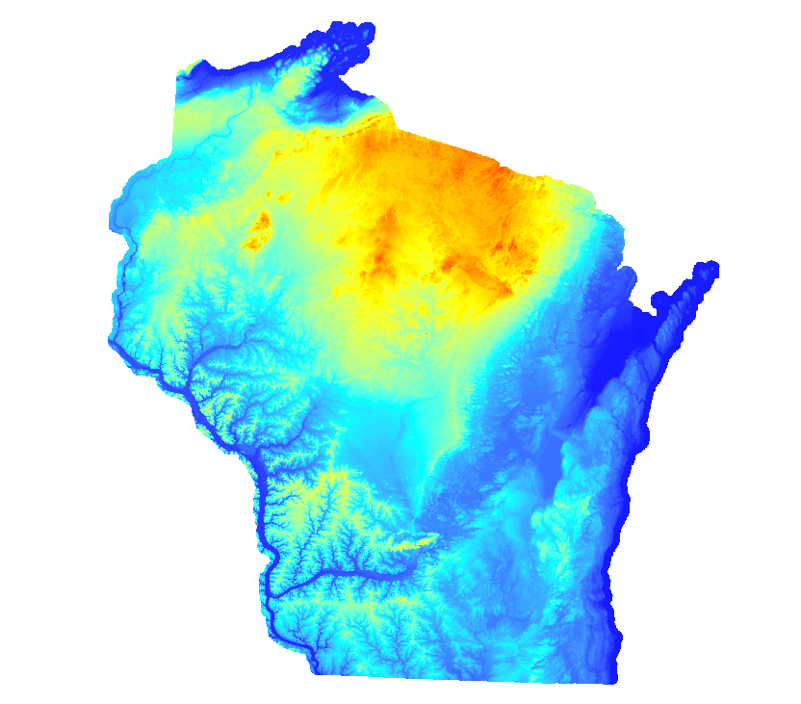

Slide 47
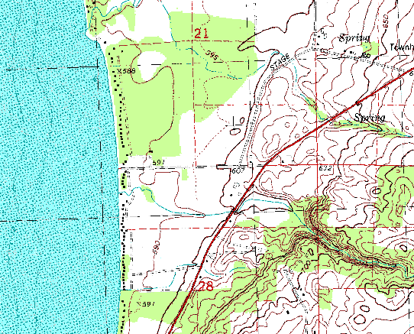
Digital Raster Graphic

Slide 48
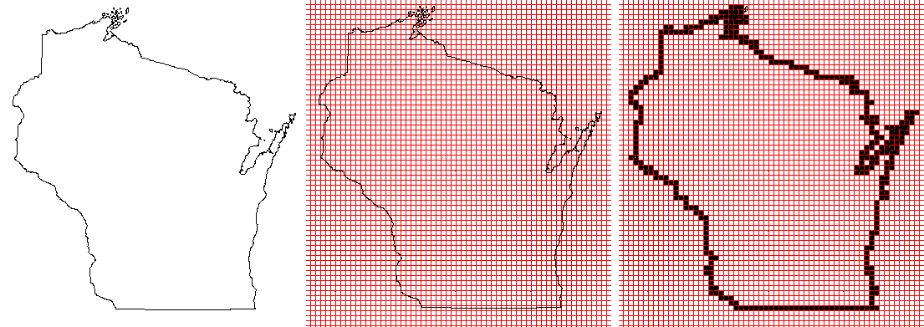
Converting Vector to Raster Data is Easy

Slide 49
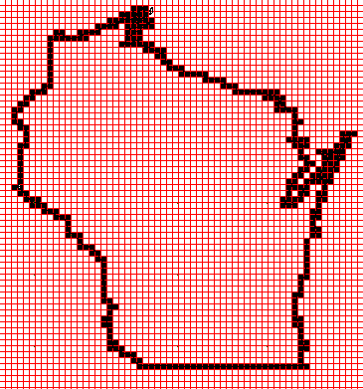
Converting Raster Data to Vector is Hard Nearly Impossible

Slide 50
Issues w/ Raster & Vector

